Slide 1
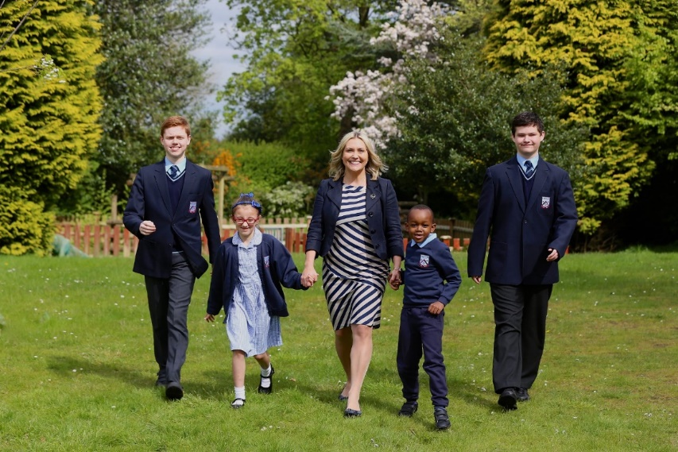
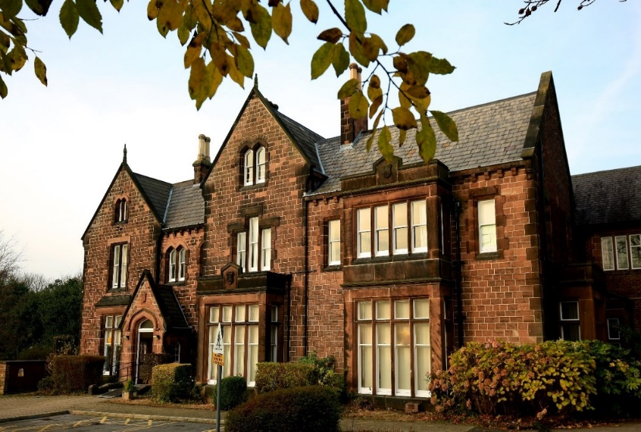
Welcome to Abbot’s Lea School

Slide 2
70+ Years of Service
Est: 1952

Slide 3
Our Vision and Mission Statement
To be the international Centre of Excellence in Autism education, research and professional development
Our Motto
We want Abbot’s Lea to be the best specialist school in the world!

Slide 4
Our Philosophy of Education: The ASD Model ©
In our work with the students, we will focus equally on:
1. Academic progress
2. Specialist therapeutic support
3. Development of life skills
Academic progress
Specialist therapeutic support

Slide 5
Our Code of Conduct: The Golden Rules ©:
1. Be here. Every day…
2. Work hard and be nice
3. Never give up on yourself and others
4. Stay positive and be happy!

Slide 6
Our holistic offer
Primary and Secondary Departments (24 classes):
Primary and Secondary Department, with 5 key stages:
Early Years Foundation Stage and Key Stage 1
Key Stage 2
Key Stage 3
Key Stage 4
Key Stage 5 (post-16)
Therapy Department:
Positive Behaviour Support (PBS)
Speech and Language Therapy (SALT)
Occupational Therapy and Sensory Integration (OT/SI)
Child Psychotherapy
Safeguarding Team
School Business Support Team
Governing Body
Therapy Assistant

Slide 7
Teaching and Learning
Assistant Headteacher
Supported Interns Job Coach
Class Teachers
Higher Level Teaching Assistants (HLTA)
Teaching Assistants (TAs)
LSAs

Slide 8
Specialist therapeutic support
Head of Therapies
Child
Psychotherapist
Speech and Language Therapist
Occupational Therapist
Therapy Assistant
Positive Behaviour Support Assistants

Slide 9
Admissions
207
Our school’s official DfE approved admission number
Adding permissible 10% (as per DfE guidance)
Current roll (in light of LCC SEND pressures for admissions)
Current oversubscription level: 45 students (~20% over maximum permissible capacity)
227
272

Slide 10
Admission Process – STEP 1 (criteria)
EHCP
Diagnosis of Autism
Diagnosis of cognitive Learning Difficulties of at least Moderate (MLD) level
Admission Policy criteria:
If “yes” to all, see Step 2

Slide 11
Admission Process – STEP 2 (processing)
EHCP
Exploring school options
Request for ALS to LA SEND Team
ALS consideration of needs (as above) and vacancies (as per previous slide)
ALS response to LA
LA response to family
Place allocation

Slide 12
Admission Process – STEP 3 (admission)
Admission:
Once a place is allocated, a start date is confirmed by the LA.
Our school Office team begin the administrative process of admission.
If admission is in September, Transition Week in July is used to help with the change of placement. This is the last week of each school year and during that time, all students are grouped in their next year’s classes. We then invite all students who will be joining us in September to spend as much of their week with us as possible to help with familiarisation and to lower anxiety over the summer.
If it is an in-year admission, flexible approach is used to achieve the same aim, and to meet the Class Teacher and see the class in operation prior to start date.

Slide 13
Admission Process – practicalities
Uniform
Transport
Attendance
Communications
Co-production and engagement
https://www.abbotsleaschool.co.uk/starting-abbots-lea-school/

Slide 14
Family Engagement and Support
Training sessions and advice
Signposting to support available
Workshops and cultural sessions
Coffee mornings (PTA)
School tours for families

Slide 15
Mrs Ania Hildrey, Headteacher of Abbot’s Lea School
headteacher@abbotsleaschool.co.uk
reception@abbotsleaschool.co.uk
Twitter and Facebook:
@AbbotsLeaSchool

Slide 16
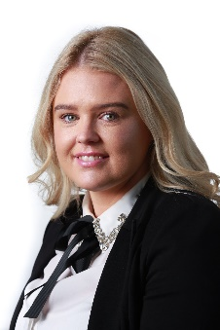
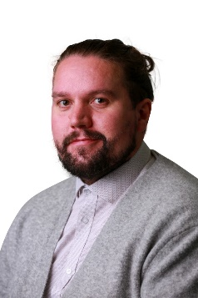
School Tours with our Assistant Headteachers
Mrs Cartwright Assistant Headteacher – Primary Department Early Years and KS1 (age 3-7) Key Stage 2 (age 7-11) | Mr Mason Assistant Headteacher – Secondary Department Key Stage 3 (age 11-14) Key Stage 4 (age 14-16) Key Stage 5 (post-16)

