Slide 1
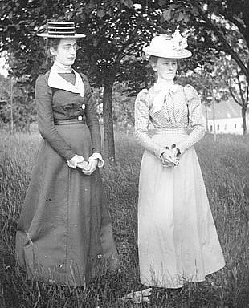
1900’s Women
The role and rights of women in the 1900’s

Slide 2
Were women seen as equal?
Women and men were not equal in the 19th century. Women were seen as 'the weaker sex'. This particularly affected middle class women because they had no reason to leave the home or go to work. The middle classes took the role of women very seriously because they did not have to worry about things like poverty. The ideal woman was to be 'the angel in the house' and support her husband.

Slide 3
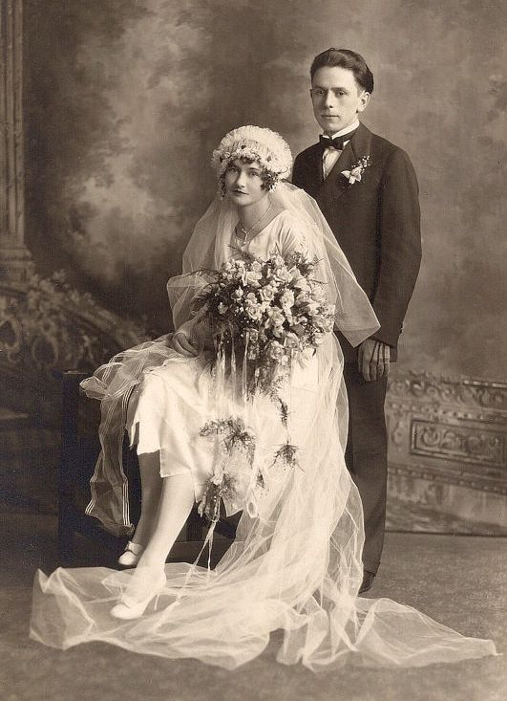
Rights for married women …
At the beginning of the century, women had very few rights of their own, particularly once they were married. Upon marriage, women became the property of their husband. A remnant of this can still be seen today with married women taking their husband’s surname. It was never the other way round.
Whilst divorce was very unfashionable in general, it was possible for men to divorce their wives for a variety of reasons, like them failing to look after their needs properly or committing adultery. It wasn't until half way through the century (1857) that women could divorce an abusive husband.

Slide 4
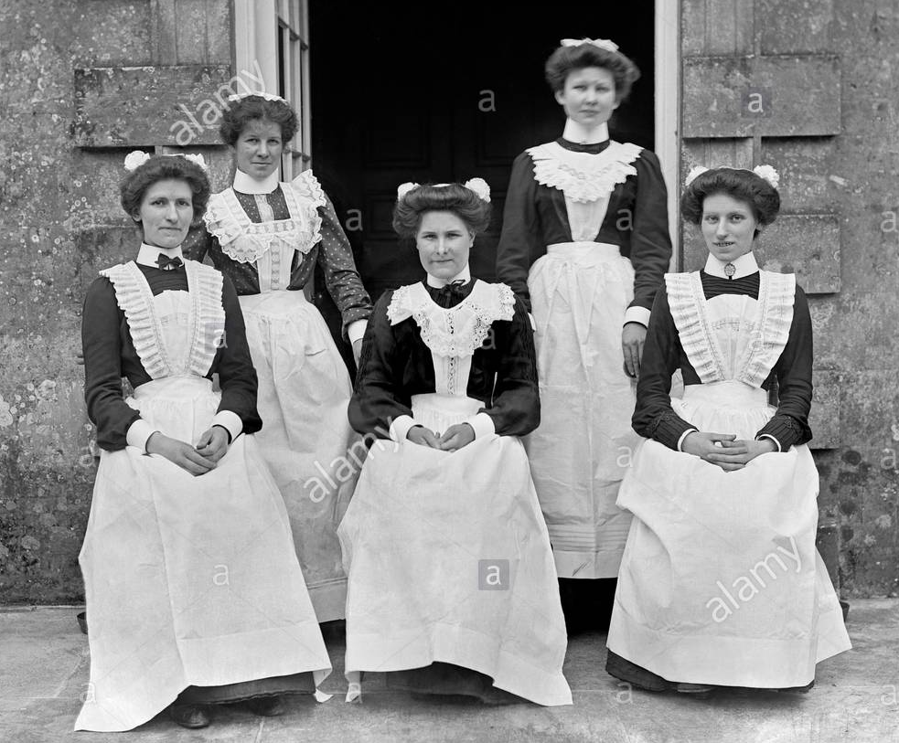
Working women…
There was a view that women should not work. However in industries such as textiles whole branches of an industry were reliant upon the labour of women. Even after 1842, women were still involved in coal mining, but only above ground. In agriculture and domestic service women were an essential part of the workforce. A few middle class women worked before they got married. However, once married, whatever they had earned became the property of their husband, just like them.
Politics and government were matters for men. Women supposedly did not have the brain capacity to understand such things and so they were entirely excluded from the process. Women could not vote, no matter who they were and there were certainly no women in Parliament.

Slide 5
Woking women the year 1900
Type of employment | Number of women employed
Domestic Servants | 1,740,800
Teachers | 124,000
Nurses | 68,000
Doctors | 212
Architects | 2

Slide 6
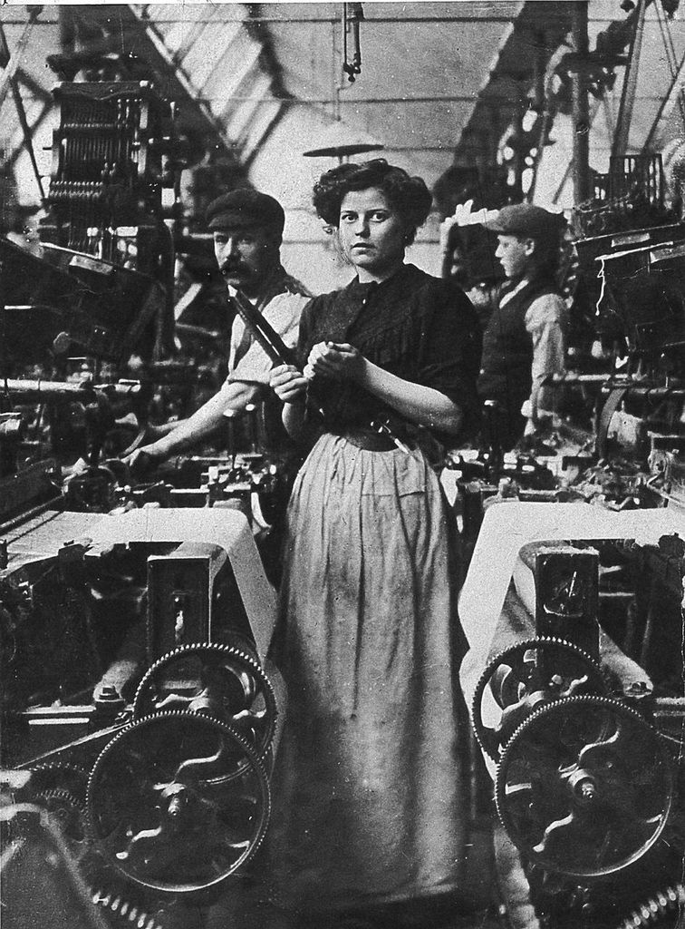
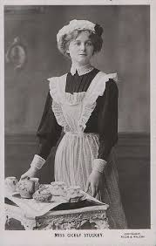
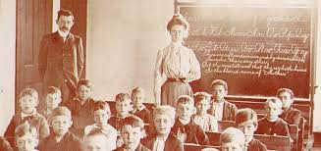
Working women…
The table clearly shows in which direction women were expected to go should they have work. Many poorly educated young ladies simply worked for a large household as a servant. From here they could train to work in a kitchen but it is highly unlikely that they would have become the head of a kitchen as this was still the ‘territory’ of the male.

Slide 7
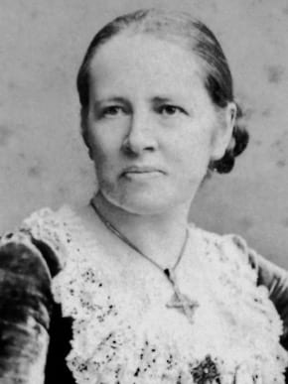
Elizabeth Garret Anderson
Towards the end of the C19th, Elizabeth Garrett Anderson became the first lady to qualify to be a doctor (GP). She then faced huge obstacles making progress in her profession. Men would not go to her simply because she was female , whereas, women usually kept with the way it was done then – they continued seeing a male GP. It took years for Anderson to succeed.
Elizabeth Garret Anderson

Slide 8
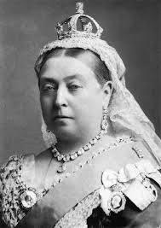
Queen Victoria…
For decades women’s progress in British society was haunted by the words of Queen Victoria:
“Let women be what God intended, a helpmate for man, but with totally different duties and vocations.”
Coming from the most famous woman in the world at the time, men in power used these words to hinder the advance women had made.
Queen Victoria

Slide 9
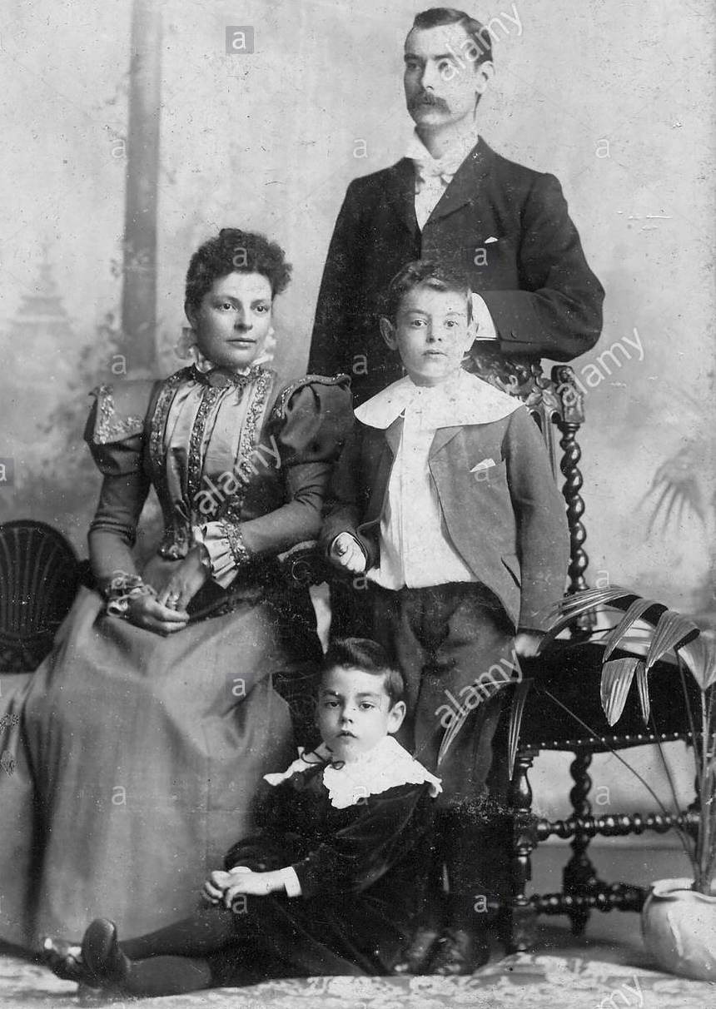
Victorian England
The myth that Victorian Britain was the time of great family values in that the family unit stayed together, is just that – a myth. Many wives could not leave their husbands even if they wanted to, simply because they did not have the financial independence that was needed to survive at the time. Also a divorced woman was shunned by society and treated as an outcast. With these obstacles, many women were forced to stay in unhappy marriages.

