Slide 1
The Suffragettes
The campaign for women’s vote

Slide 2
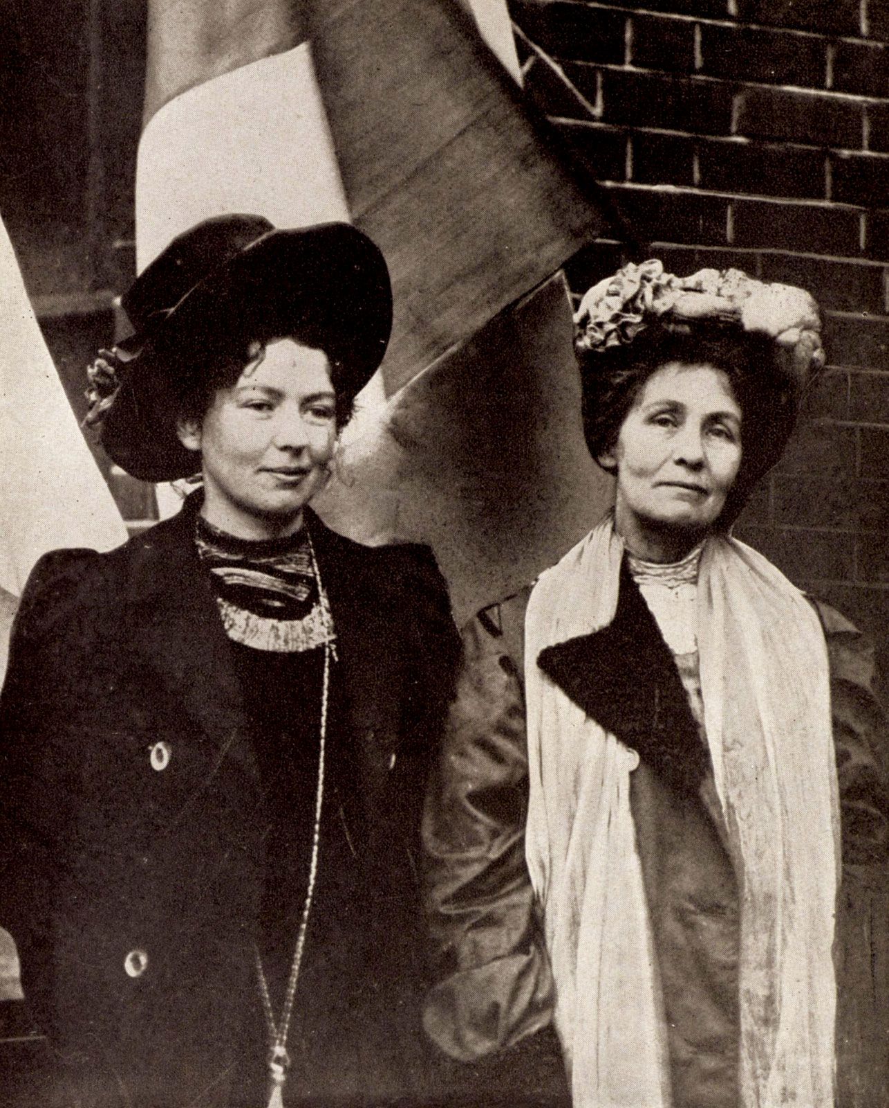
The Suffragettes
In 1903, the Women's Social and Political Union (WSPU – the Suffragettes) was formed, led by Emmeline Pankhurst. It was run by Mrs Pankhurst and her daughter Christabel.
Emmeline and Christabel Pankhurst

Slide 3
The Suffagettes
The Suffragettes believed in civil disobedience. They:
disrupted Parliament
chained themselves to railings
broke windows
burned down churches
held huge marches and demonstrations
attacked politicians
set post-boxes on fire
slashed paintings
went on hunger strike when arrested

Slide 4
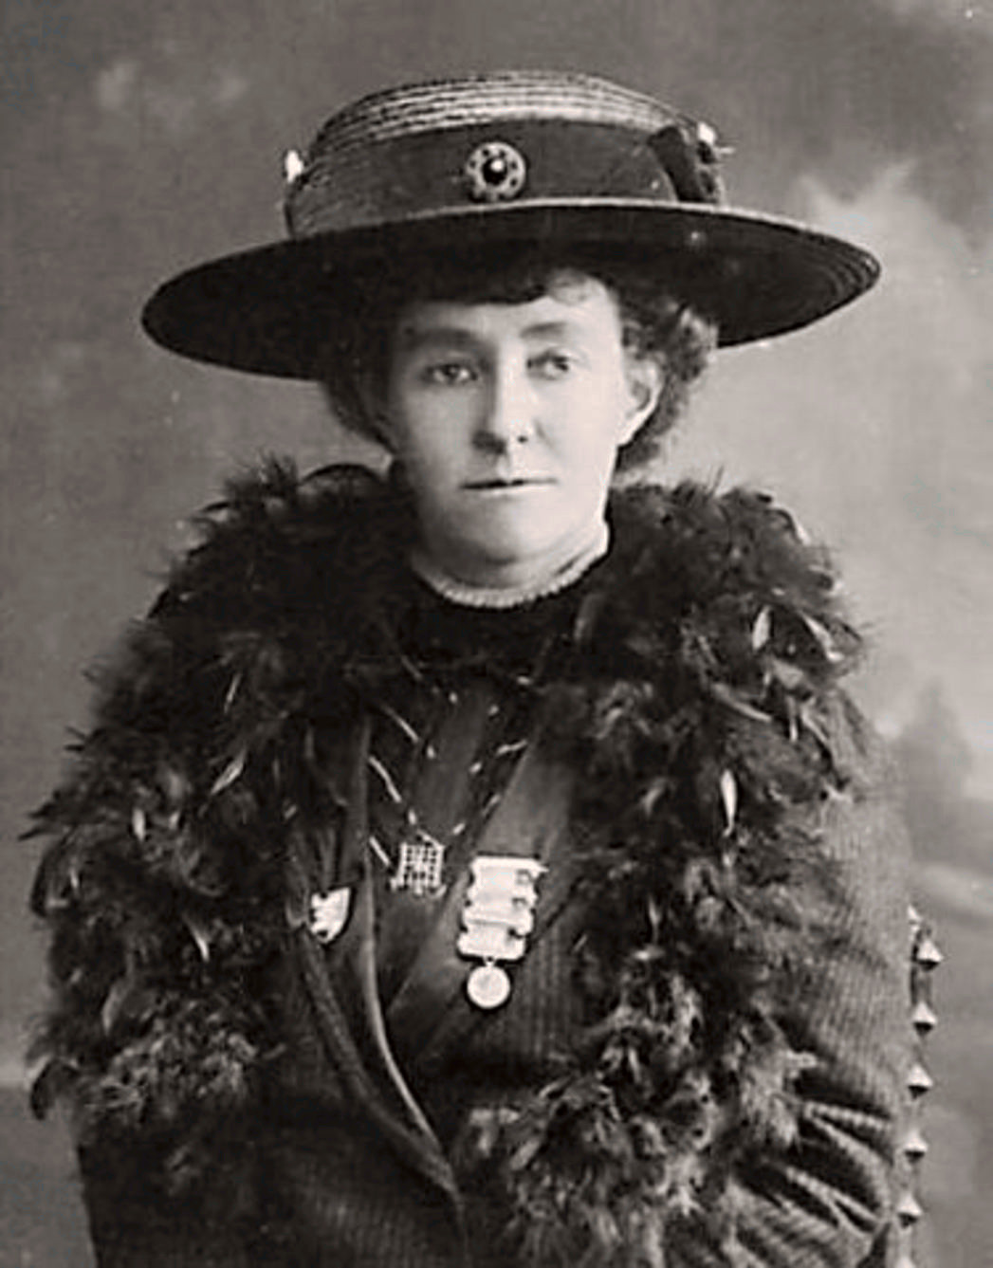
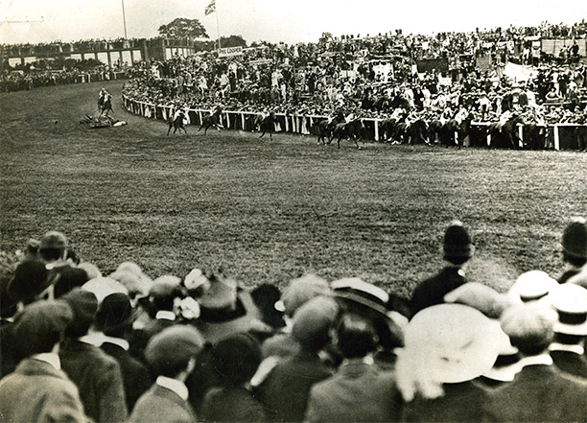
The Suffragettes
Emily Davison threw herself under the king's horse in the 1913 Derby race. In 1913, Emmeline Pankhurst declared that the WSPU were 'guerrillists', who would destroy anything other than human life to get the vote.
The race that Emily threw herself at the horse.
Emily Davison

Slide 5
The Suffragettes
The Suffragettes, however, had not won the vote by 1914:
Many bills were presented to Parliament between 1900 and 1914, but they were all defeated.
In 1910, the Men's National League for Opposing Women's Franchise merged with the Women's National Anti-Suffrage League to form the National League for Opposing Women's Suffrage. It published the Anti-Suffrage Review, which said that women were not fit for government and that Suffragettes neglected their families.
In 1914, when the war broke out, Emmeline Pankhurst stopped the campaign and urged women to support the war instead.

