Slide 1
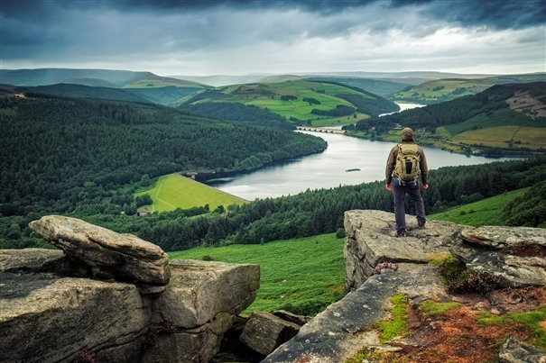
Our Outdoors
In this project we will be:
Practicing our drawing skills.
Experimenting with different materials
Testing our observation skills

Slide 2
L.O: We are working on our drawing and memory skills
TASK
You are going to do 2 drawings from a window in your house.
Drawing 1. Look at everything outside your window. Take 2 minutes and try to take a mental picture of everything you see. Now draw everything you could see from memory! Make sure you do not look out the window again! This drawing is completely from memory!
Drawing 2. Now draw the same picture but this time you can look outside as you draw! Make sure you look carefully and draw everything you see!

